Slide 1

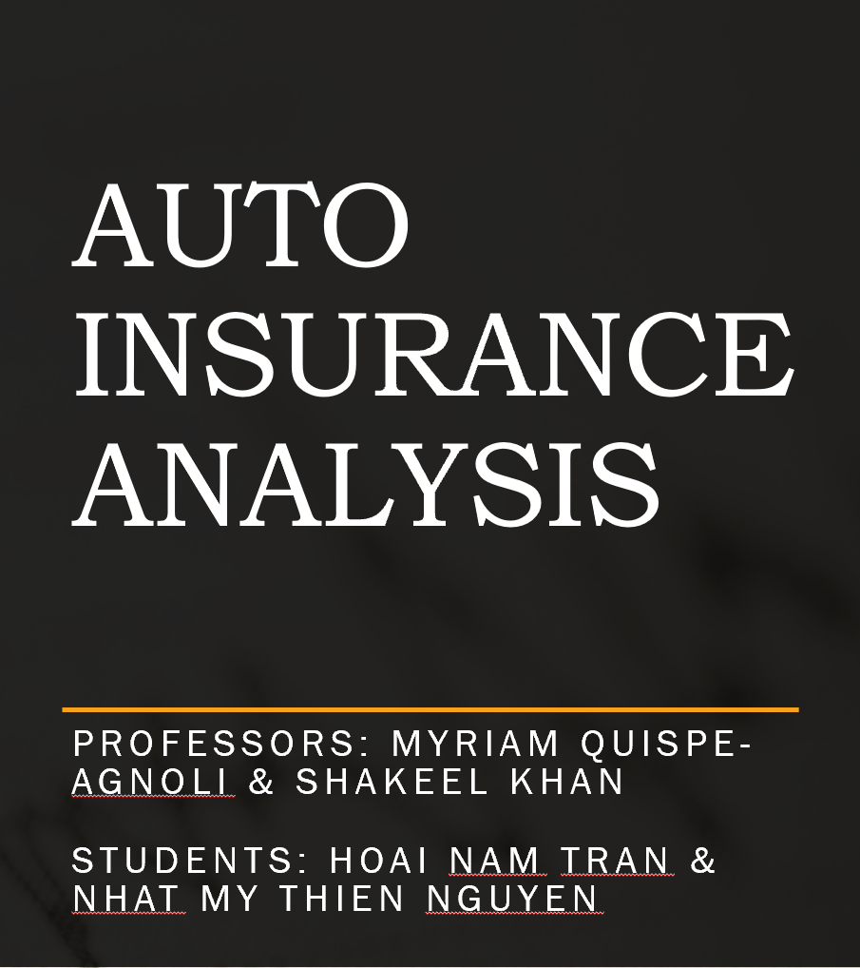

Slide 2
Outline
Project Goals
Dataset & Source
Exploratory Data Analysis
Data Mining Task & Technique Selection
Technique Application
Performance Evaluation
Conclusion & Recommendation

Slide 3
Project Goals
Business Question?
1) What is Customer Lifetime Value based on their background and insurance history and how we could increase revenue by focus on certain type of customers.
2) Whether a customer will accept insurance renewal offer from company and how to improve renewal rate of customers?

Slide 4
Dataset & Source
Dimension:
9134 observations and 24 variables
https://www.kaggle.com/pankajjsh06/ibm-watson-marketing-customer-value-data

Slide 5
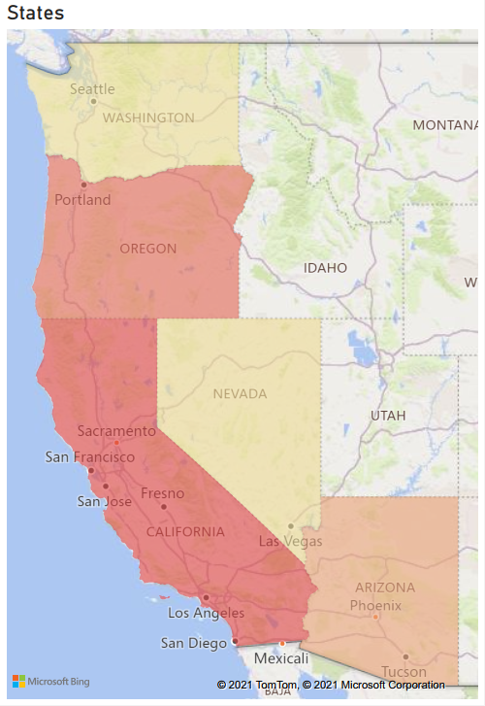
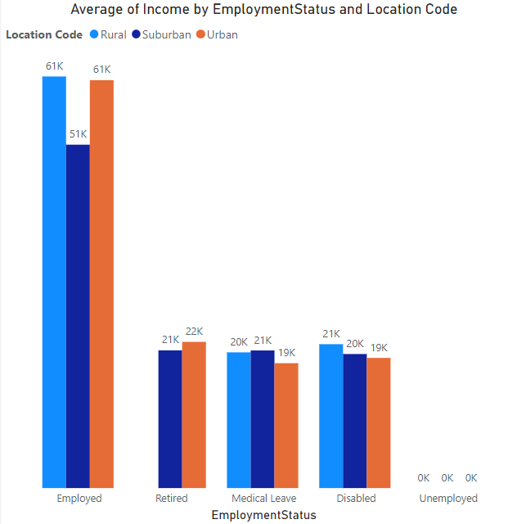
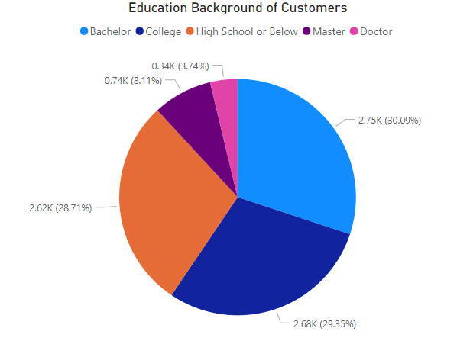
Who are the customers?
Most of customers have at least college education, and 28.71% of customers have high school or below.
Employed customers are majority with more than $51K of average income. Retired, medical leave and disabled customer have similar average income from $19K to $21K.
The market is the West, includes California, Oregon, Arizona, Nevada and Washington.

Slide 6
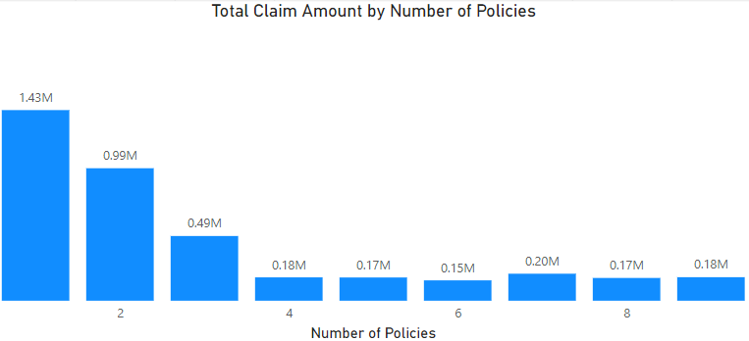
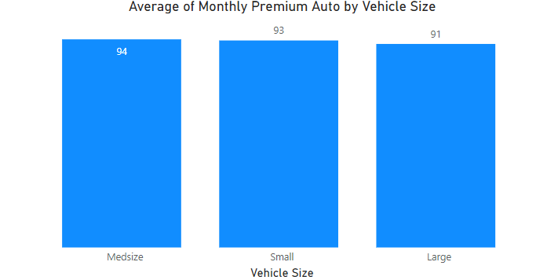
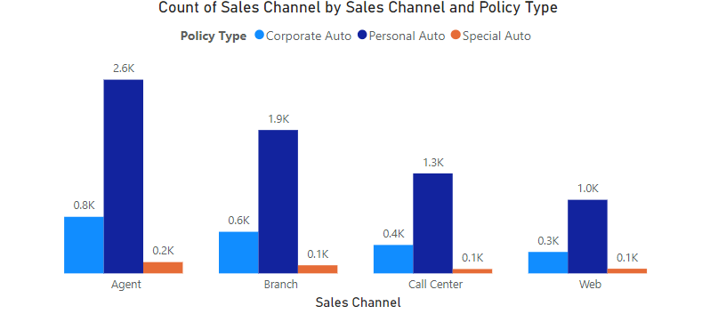
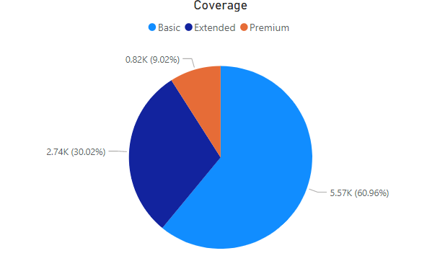
What are customer’s behaviors?
Customers with 1 and 2 policies have the biggest claim amount, while there not much difference of claim amount between customers who owns more than 3 policies.
Average monthly payment of customers who own different vehicle size are quite similar.
Most of customers bought insurance via Agent, least of them bought via web. Personal auto policy accounts for majority, while very few special auto policy were sold.
Most of customer chose the Basic coverage, and only 9.02% customers chose the Premium coverage.

Slide 7
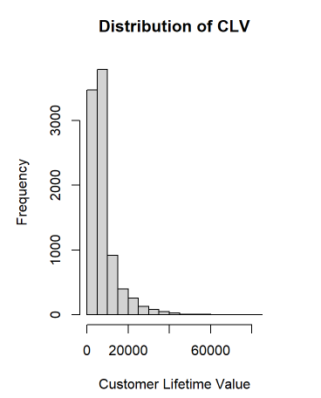
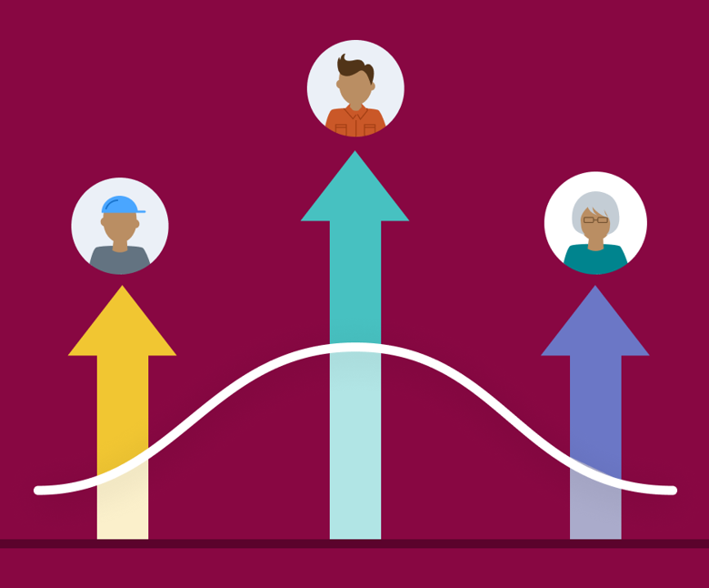
Customer Lifetime Value
Customer lifetime value (CLTV) also referred as the lifetime value of a customer represents the total amount of money a customer is expected to spend in your business, or on your products, during their lifetime with your business.
How is our CLV ?
How can increase CLV?
Most of our CLV is under $10000. About 5% of customers have extreme value.

Slide 8
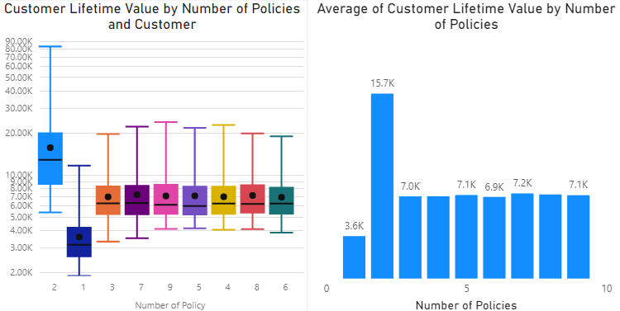
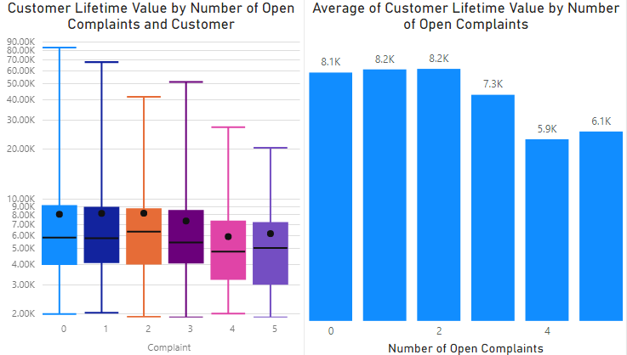
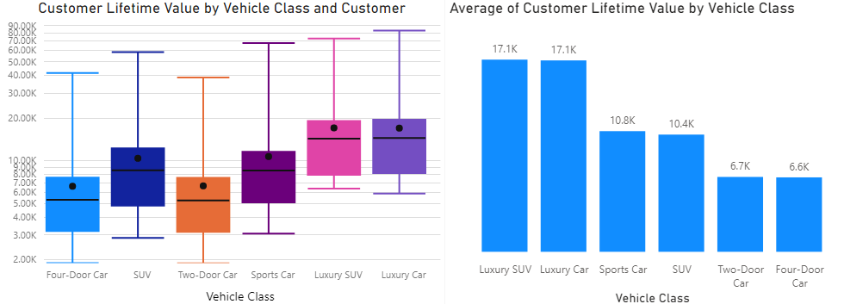
Associations between CLV and other variables?
Number of Policy look have strong impact on CLV.
Group into 3 smaller group (1p, 2p, and more than 2p).
CLV is different between number of complaints category.
Group into 2 smaller group (from 1-3 complaints, more than 3 complaints).
CLV is different between vehicle class
Group into 3 smaller group based on their similarity:
Luxury Car (Luxury SUV, Luxury Car)
Mid Class Car ( Sports Car, SUV)
Normal Car ( 2-Door Car, 4 Door Car)

Slide 9
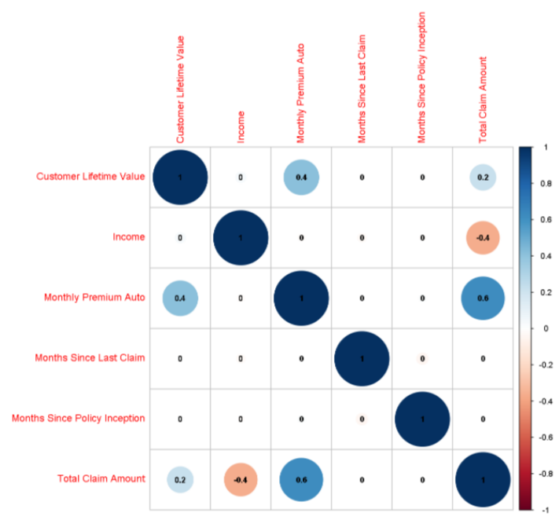
Associations between CLV and other variables?
The correlation between CLV and other numerical are weak.
A moderate positive relation between CLV and Monthly Payment.

Slide 10
Models to predict Customer Lifetime Value
First, we simply divide randomly the cleaned dataset into 60% of train data and 40% of valid data and then run three below model.
Model 1: Linear Regression with all variables, then select and run model with significant variables at 95% of confidence.
Model 2: Use BMA technique that use BIC criteria for suggesting variables, then run model with all suggested variables.
Model 3: Use STEPWISE technique for suggesting variables, then run model with all suggested variables.

Slide 11
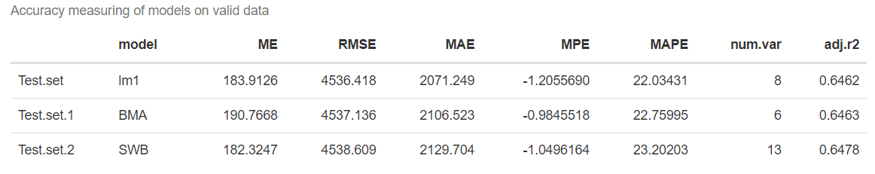
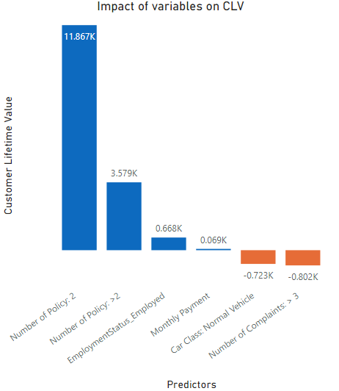
Evaluating
The performances of three models in the valid data are not much different.
We could choose model 2 (BMA) because this model uses the fewest variables ( parsimonious model).
Num.of.Policies_2: 11867.1, the most valued customers are people who buy 2 policies, the revenue from these customer higher $11867 than customer who just buy 1 policy.
Num.of.Policies_More.than.2: 3578.6 customer who buy more than 2 policies have revenue higher than that of customer buy 1 policy, about $3579.
EmploymentStatus_Employed: 667.9 The customer with employed status will bring higher $668 revenue to company than disable customer.
Monthly.Premium.Auto: 68.6 the monthly payment of customer increases $1, that would cause the increase of 69 dollar of Customer Lifetime Value.
New.Car.Class_Normal.Vehicle: -723.1 comparing to luxury vehicle class, revenue from customer who buy insurance for normal vehicles is less than $723.
Num.of.Complaints_More.than.3: -801.9, the value of customers who have more than 3 complaints is lower about $802 than that of customers have less than 3 complaints.
Interpreting

Slide 12

Recommendation
HOW COULD WE DO TO INCREASE CLV ?
Reaching new feasible customers who are employed and try to sell contracts with at least 2 policies
Introducing good promotions to attract customers buy insurance for their luxury vehicles.
Improving the customer services to reduce the complains.

Slide 13
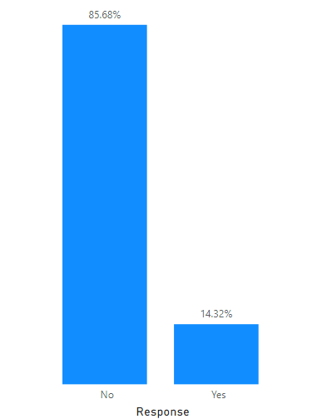
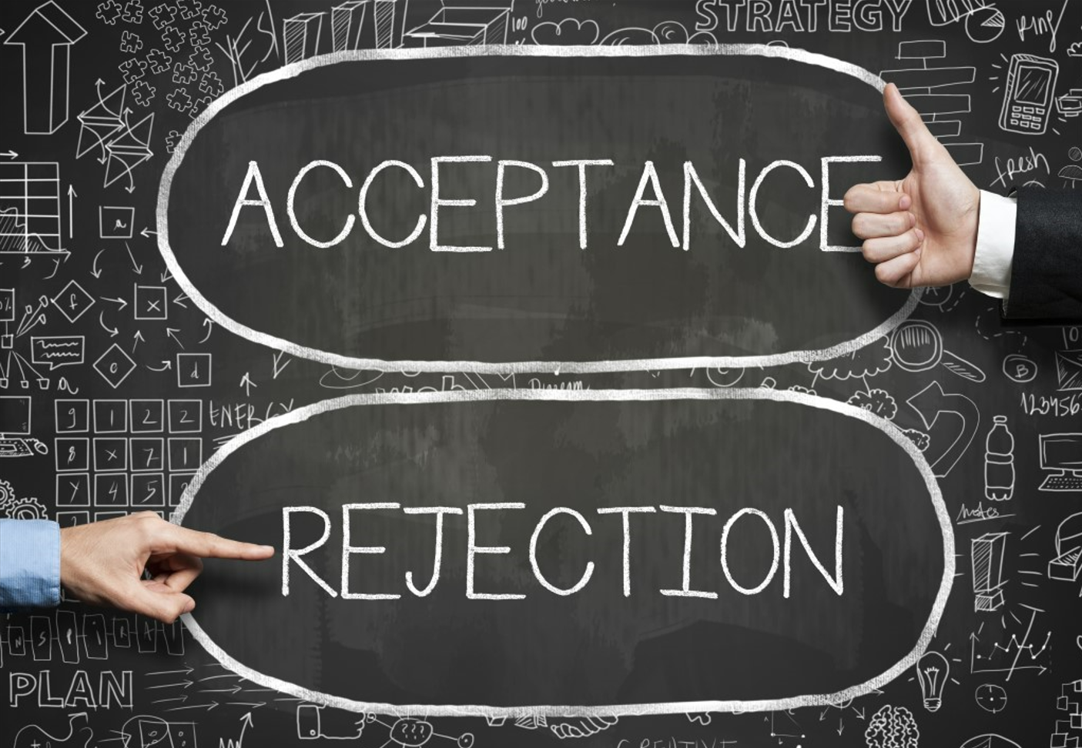
How was renewal acceptance rate of company?
Most of customers did not accept a renewal offer when the current contracts expire. We got only 14.32% of customer responsing Yes.
Which features effect the customers’ acceptance? And How can we improve the situation?

Slide 14
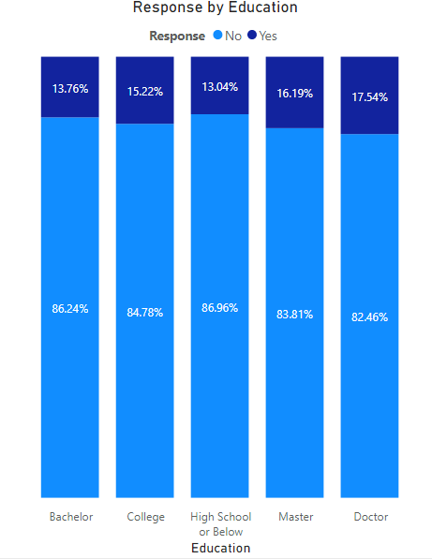
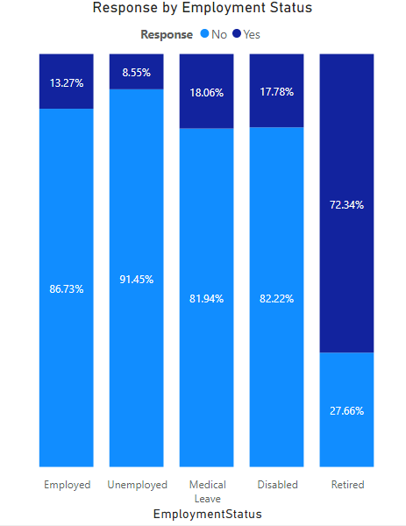
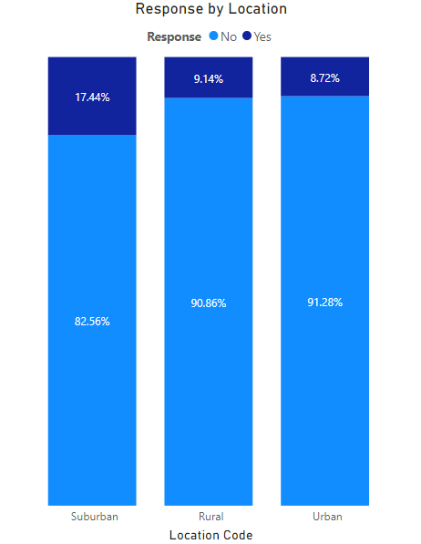
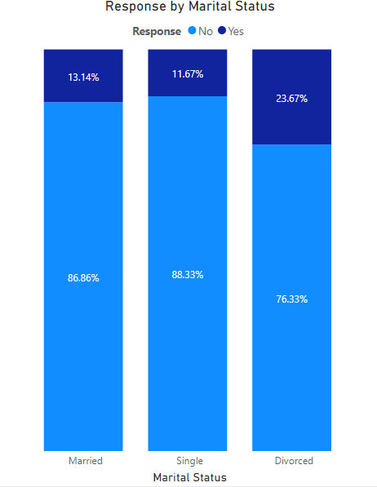
Associations between Response and other variables?
The acceptance ratio of High education people looks higher than that of people who do not have degree.
Customer who retired seem much easily say YES than other groups, and Unemployed customers have lowest rate of acceptance.
The ratio of Yes responses of suburban customers is much higher than that of urban and rural customers.
The ratio of Yes response of divorced customers is double that of married and single customers.

Slide 15
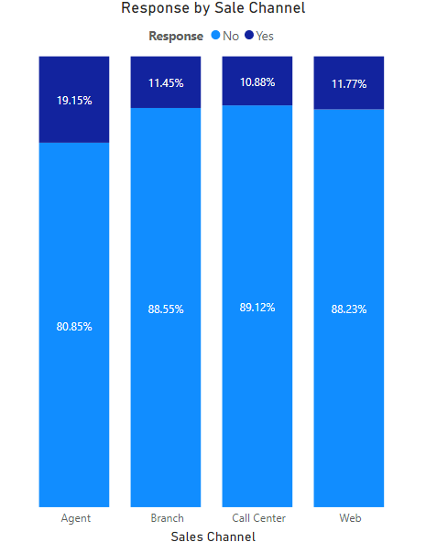
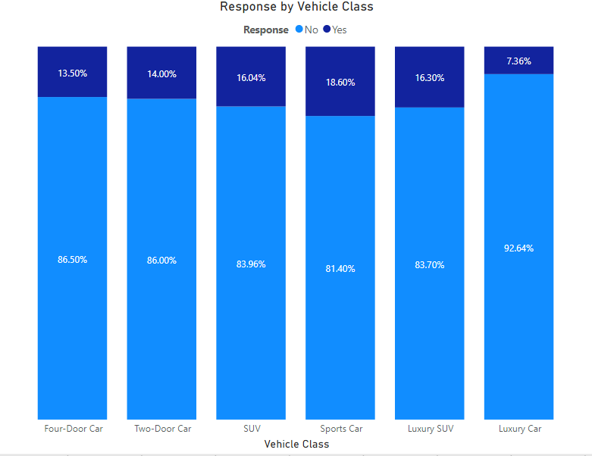
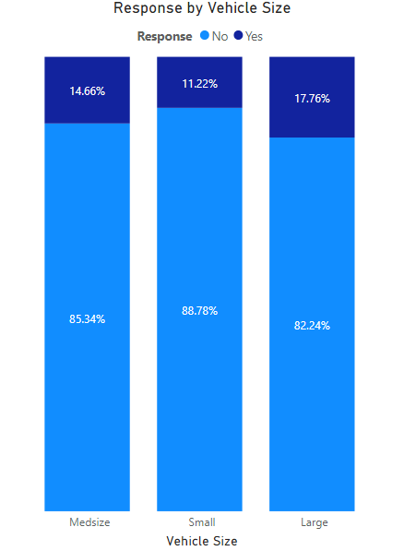
Associations between Response and other variables?
Customers response Yes to renewal offer via agents more than other sale channels
Customers owning an Sport car have highest ratio of accept renewal offer, while those owning Luxury car have lowest rate of Yes response.
Customers who use large vehicle have highest probability of accepting renewal offer, while customers who use small vehicle have lowest probability.

Slide 16
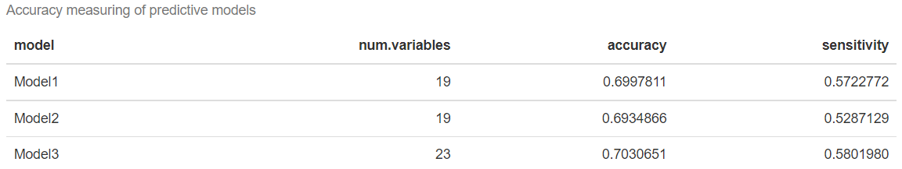
Models to predict Response
First, because the Yes response is only ~14%, we need to use oversampling technique to better perform prediction of Yes.
We partition the dataset to 60% of training data and 40% of validation.
Model 1: Logistic Regression with all variables, then select and run model with significant variables at 95% of confidence.
Model 2: Use BMA technique that use BIC criteria for suggesting variables, then run model with all suggested variables.
Model 3: Use STEPWISE technique for suggesting variables, then run model with all suggested variables.
Evaluating on validation data.

Slide 17
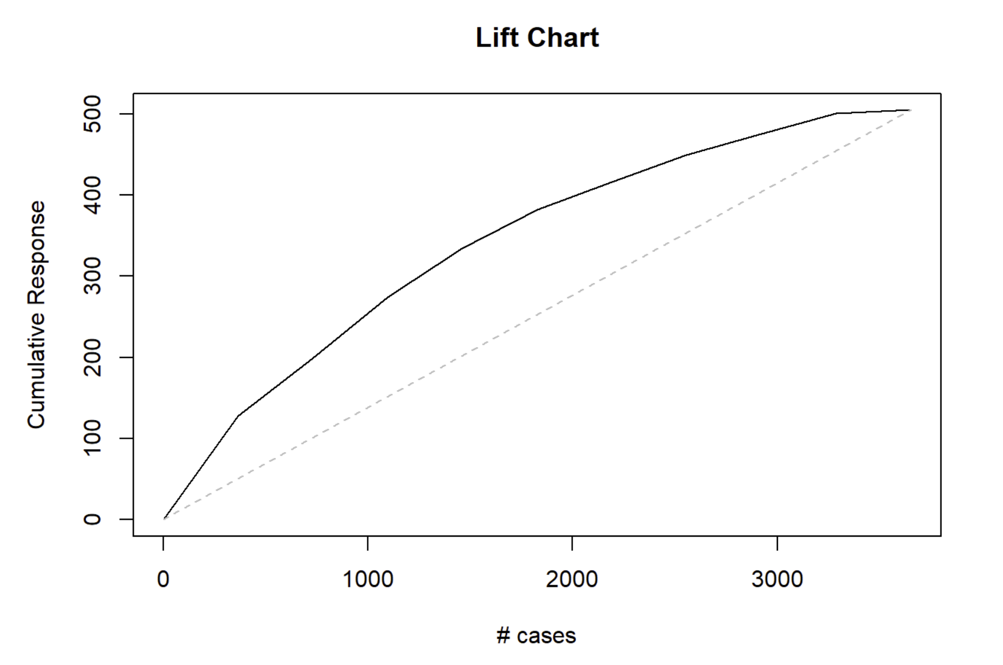
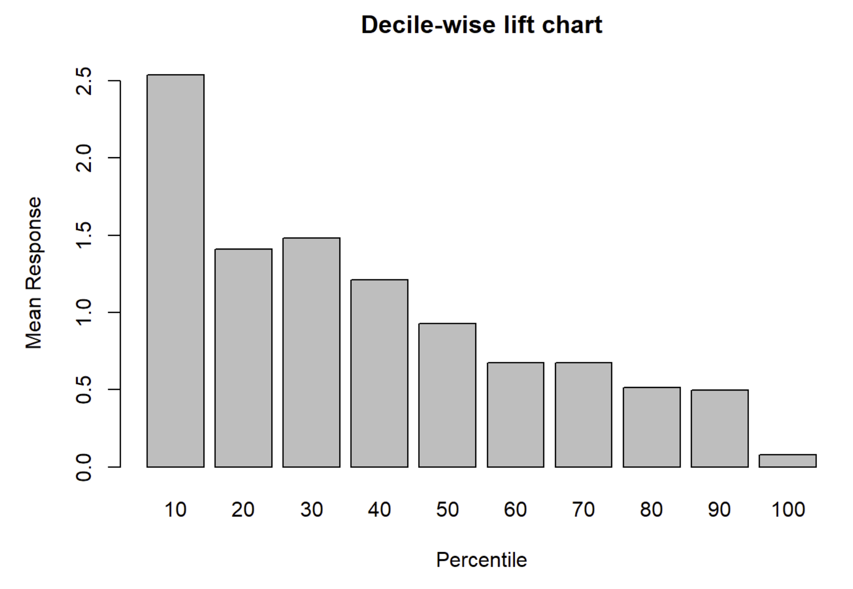
PERFORMANCE EVALUATION
If we take the first 2000 customers in order of the highest propensity for accepting offer, we will choose about 400 customers correctly more than if we pick 2000 customers randomly.
The model predict 2.5 times as many customers who accept the offer in the first 10% of customers than if we choose 10% of customers randomly.

Slide 18
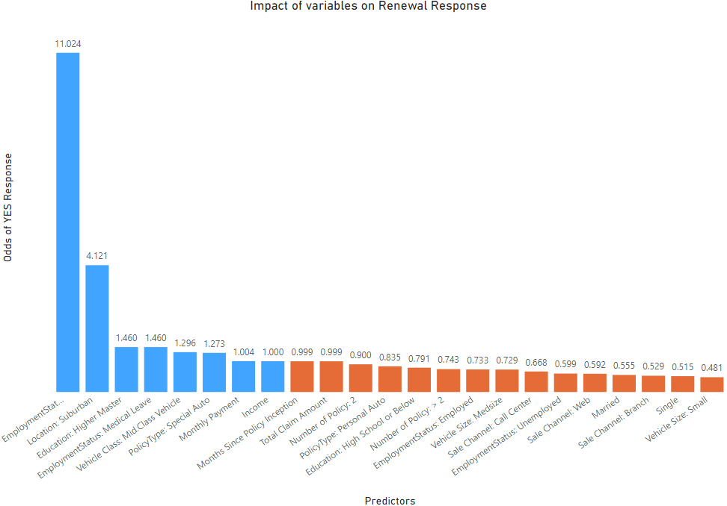
INTERPRETING MODEL
There are 8 factors increase the odds of response Yes.
Retired customers increase the odds of acceptance by 11.02.
Customers living in Suburban increase the odds of acceptance by 4.12.
There are 15 factors decrease the odds of acceptance.

Slide 19
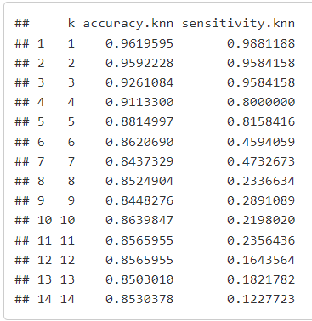
K-NN method
We chose k=3 which is an odd number to ensure there is no tie and it balances between overfitting and ignoring the predictor information.
Using knn to classification, we have the accuracy rate = 92.61%, sensitivity rate = 95.84%. KNN performs super great in this case of classification.

Slide 20
Conclusion and Recommendation
HOW COULD WE DO TO INCREASE RENEWAL RATE ?
The company should focus on retired customers, divorced customers and people who live in suburban areas.
Agents are important channel to sell insurance and convince customers to accept renew offers
Customers with large size vehicles are easy to accept new offers.
To classify whether new customer will accept the offer, using Knn technique is the best choice.

Slide 21
THANK YOU!

